Slide 1
BA Applications with Python
Group 9
April 2024
Merijn Boersma 673514 | Leon Gramminger 673482 | Tu Le 558957 | Sara Onderišinová 580791 | Gijs Werkman 615815
Notes:
Script
Hi there, I'm Gijs, and together with Merijn, Tim and Huy we'd like to present how we tackled our project on optimizing RSM's classroom scheduling. We focused on predicting student enrollments for the 2023/24 academic year, using historical data and various predictive models. This presentation will cover our methods, key findings, and recommendations for effective classroom allocation.
G[25]

Slide 2
Table of contents
1 | Data Engineering | 3
2 | Descriptives | 7
3 | Modelling | 11
Notes:
Script
Let's briefly outline the roadmap of our presentation. We'll start with the initial data analysis, moving through our model selection and evaluation process, and ending with actionable insights and recommendations for RSM's classroom scheduling. Let’s get started!
G[17]

Slide 3
1. Data Engineering
Notes:
Merijn

Slide 4
1.1. Merging the Data Files
Organization.csv
Investments.csv
Organization is cleaned first and then merged
Investments is merged first and then cleaned
Merged.csv
Acquisitions.csv
Rounds.csv
Acquisitions is cleaned first and then merged
Rounds is merged first and then cleaned
Notes:
Merijn
We started off with the four files about start-ups and their characteristics aiming to predict start-up funding. Before doing the final merge between all datasets, we first did some cleaning on the datasets organisation and acquisitions as this was required before merging the two. For investments and rounds we first merged them afterwhich we did the cleaning. After these two files were ready we merged everything together.

Slide 5
1.2. Data Cleaning
1
3
5
Standardization
Missing values
Currency
Several variable names needed reformatting
These were transformed so they are machine processible
All rows with missing values in the target variable are dropped.
The rest is kept and filled with ‘None’, 0 or the median depending on the nature of the variable.
There was one row, showing other currencies than USD.
This column was transformed using an API to replace the local currency to USD.
2
4
Encoding
Multiple categories
The permalink columns were encoded.
Each start-up, investor or acquirer was given a unique number.
Some variables contain multiple categories, for example category_list.
Each value was extracted, then the frequency was counted and only the 15 most frequent values were kept.
5
Notes:
Merijn
There were still a great number of columns and values that needed adjustment so they were machine processible. We started off with standardizing the format of the variable names, then encoded all the permalinks, replacing the missing values either with none, zero or the median depending on the variable, adjusting some categorical variables so they only included 1 category and transforming all currency to USD.

Slide 6
1.3. Data Engineering
Data Engineering
Creating new variables
World bank data
Transforming data
Sub-tasks
Create new variables for the date columns representing the year, month and day of the year
The variable funding_rounds was created, indicating the number of funding rounds a start-up took part in.
Data from the world bank was imported using their API and was selected based on its relevance to the start-up funding environment
The imported data consisted of:
GDP per capita
Foreign direct investment
GDP growth
Interest rates
Female participation
The variable funding_round_code was transformed so it indicates a number from 1 to 8 representing the rounds’ rank
Investor_name was transformed to only the 50 most frequent investors were included as dummies.
Notes:
Merijn
Moving on to the data engineering part, this contains three main areas of focus. We began with creating new variables, especially for the dates. We created new variables representing the year, month and day of the year. Also, we created a new variable showing the number of rounds a startup took part in and the duration between the first and the last round. Furthermore, we used data from the world bank which consisted of GDP per capita, foreign direct investment, GDP growth, interest rates and female participation. Lastly, we transformed some data so that it would be relevant and machine processible. After the data cleaning and engineering steps, we arrived to a new dataset containing just over 28 thousand rows and 103 columns. This was used for both the descriptive and modelling analysis.

Slide 7
2. Descriptives
Notes:
Sara & Tu

Slide 8
2.1. Focus features in the descriptive analysis
Funding total amount (USD)
Evaluate how the funding landscape develop over time.
Funding rounds
Investigated:
The distribution of number of rounds
The mean and median per market type
Focus features
Section Countries
Look into countries that received most funding, and those that invest the most.
This can be an indicator on dominant markets
Market types
Examined how have the markets evolved over time in terms of:
Company acquisitions
Funding rounds
(Average) funding

Slide 9
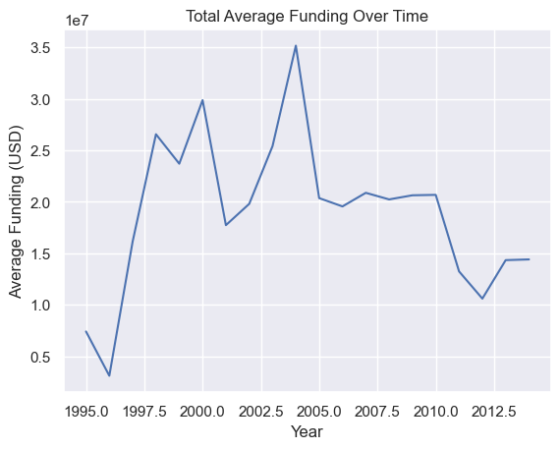
2.2. Main variable: Total Funding in USD
Steep increase in 1996: Significant economic growth
Big drop in 2001: The bursting of the dot-com bubble
The following 3 years experience a sharp recovery, which peaked in 2004
From there, the funding level experience a downward trend
In 2011, the funding is at its lowest level since 1996 (2008 global financial crisis aftermath)
Notes:
1996: significant economic growth in many countries due to factors such as technological advancements, globalization, and increased investor confidence.

Slide 10
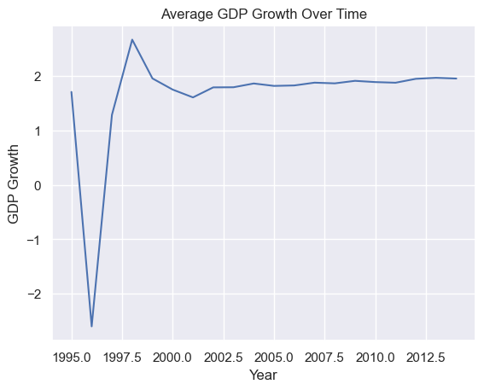
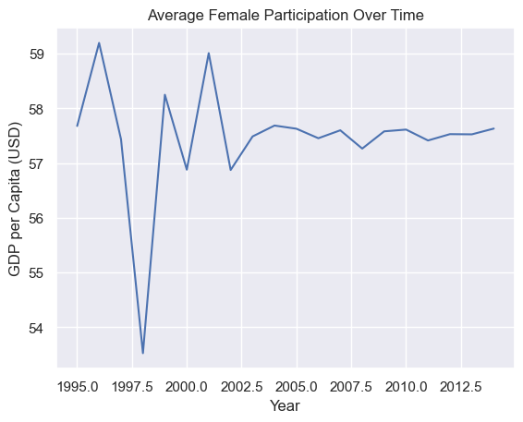
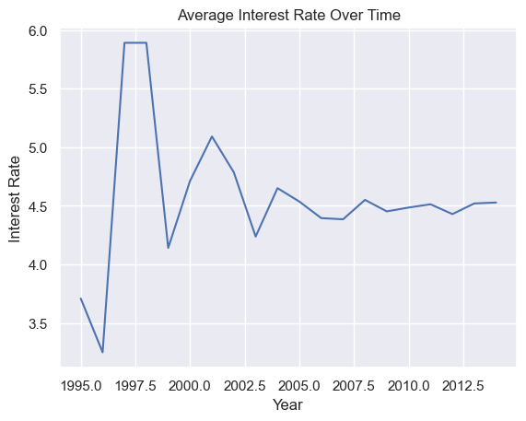
2.3. Economic Factors

Slide 11
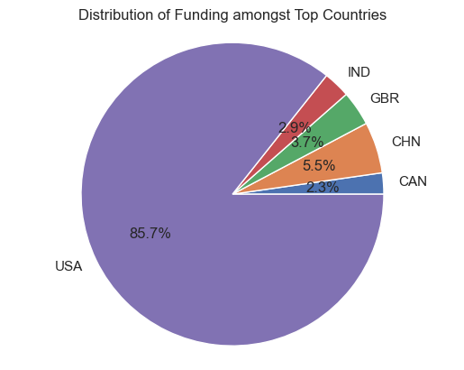
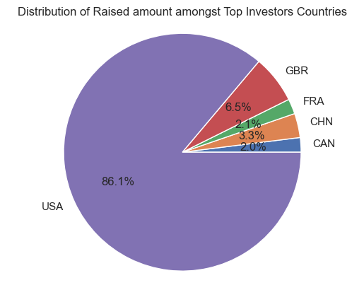
2.4. Funding and Investments distribution
Notes:
Countries that received and invest the most from 1995 to 2015

Slide 12
2.5. Distribution of total funding (USD) per market
The landscape of top-funded markets has evolved significantly over the dataset's span of more than two decades:
Initially, in 1995, consumer goods market dominated the funding landscape, but gradually disappeared from the top rankings.
By 2004, e-commerce, web-tools, and travel markets are emerging as the primary receiving markets of funding.
In 2014, a more diversified group unfolds with biotechnology, software, health care, clean technology and enterprise software holding comparable share sizes of total funding (among the top markets).
1995
2004
2014

Slide 13
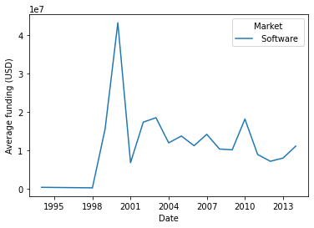
2.6. Deep-dive into specific markets: The dotcom bubble burst
Late 1990´s: abundant funding for Internet-based start-ups due to low interest rates and excitement over the adoption of Internet
Many start-ups had no record of success but were backed up by optimistic investors
Eventually, the capital funding begins to dry up
In 2000: Business collapse, market crash

Slide 14
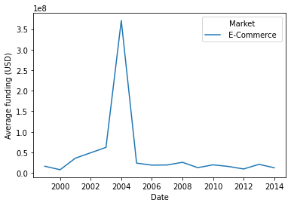
2.7. Deep-dive into specific markets: The e-commerce waves
Early 2000´s: e-commerce market transitioning from the first wave (dawn of e-commerce) to the second wave, as web-based technologies expand

Slide 15
3. Modelling
Notes:
Gijs

Slide 16
3.1. Summary of the problem
Team Goals
Problem & Opportunity
Start-up funding is influenced by many variables, creating complexity
Create a model that accurately predicts start-up funding.
Predicting total start-up funding poses enormous opportunities for investors and start-ups.
Measure how good the predictions are.
Notes:
The challenge of the modelling section was to create a model that predicts the total start-up funding, whilst navigating the complexities of the dataset. Hence, our go0al was to create a model that predicts as accurately as possible and benchmark those against each other.

Slide 17
3.2. Candidate models – Overview
K-NN
Lasso
Parameters:
K: Number of nearest neighbours: 3
Distance Metric: Euclidean distance
Parameter:
Alpha: 1.000.000
Actual number of included variables: 37
Model Selection
Parameters:
Number of Trees: 235
Max depth: 6
Max features: 0.7136
Min leaves: 6
Min sample splits: 4
Random Forests
LightGBM
Parameters:
Learning Rate: 0.1
Min data in leaf: 30
Number of trees: 600
L1 & L2 regularization term: 0
Notes:
We considered a number of models to try and evaluate various methodologies. These models are K-NN, Random Forests, LightGBM and Lasso regression. Of course we did hyperparameter tuning, all with random grid search for maximum effectiveness. The hypetrparameters you see here are the best outcomes as per the grid search.

Slide 18



3.3. Pre-processing
Data Cleaning
Feature engineering
Feature encoding
Identify columns that became redundant
Removed irrelavent columns
Creation of new feature: duration of the funding
Calculated the duration between the different funding rounds to capture momentum
Large number of categorical variables available
Usage of encoding techniques such as one hot encoding and binary encoding
Notes:
Before getting to the model results, we had to do some, often model-specific, pre-processing. This included data cleaning, where we, for instance, identified & removed redundant columns. We also did some further feature engineering, such as creating a new feature pertaining to funding round momentum. Lastly, due to the large number of categorical variables we encoded them using one hot or binary encoding, depending on the model’s capabilities.

Slide 19
3.4. Evaluation metric selection
Possible
evaluation metrics
R² score
Comparability of models
Standardized approach
Uneffected by the number of predictors
Single performance indicator
Chosen metric
R² score
MSE
MAE
Notes:
As for the evaluation metrics, we considered various options. Among those were R-squared, MSE and MAE. As you can see, in the end opted to compare all models based on a single performance metric: the r-squared score, as it is a standardized approach to comparing models that is unaffected by the number of predictors.

Slide 20
3.5. Model Benchmark
As indicated by the table, the Lasso Regression exhibits the greatest performance, closely followed by the LightGBM and Random Forest model.
The KNN exhibits the lowest R², with a relatively poor R² of 0.26, assumably due to the high dimensional space.
Lasso Regression & LightGBM benefits from internal mechanisms (e.g., regularization / boosting) that manages well complexity.
 | K-NN | Random Forest | LightGBM | Lasso Regression
R2 | 0.2618 | 0.5200 | 0.5334 | 0.5854
Notes:
Leon

Slide 21
3.6. Feature Importance – Lasso Regression
Notes:
Leon

Slide 22
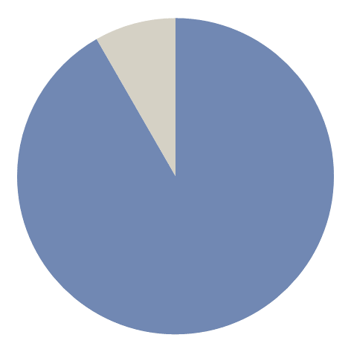
3.7. Conclusion
R² score
In the comparative analysis of predictive models, Lasso Regression proved to be the superior choice, achieving an R² score of 0.5854, indicative of a robust model with a reasonable level of explanatory power.
58.5%
Notes:
Leon

Slide 23
3.8. Limitations and Recommendations
Limitations
1.
Resource and Time Constraints: Limited computing power and deadlines restricted our model choices and refinement to 20 iterations, potentially compromising model performance.
These factors collectively suggest that while the results are promising, they are also conditional, and further research could yield further optimized results.
2.
Data Quality and Model Assumptions: Issues with data completeness and accuracy could lead to biased predictions, while unmet model assumptions may reduce effectiveness.
3.
Feature Selection and Hyperparameter Tuning: Our exploration of features and hyperparameters was limited, suggesting potential areas for improvement.
4.
External Factors and Model Suitability: We may not have fully accounted for significant external trends affecting startup success and funding. Besides, the variability of the data underscores the necessity for adaptive modeling strategies to remain effective across different conditions.
Notes:
Leon

